Slide 1

Trường Đại học Công nghệ Thông tin – Đại học Quốc gia thành phố Hồ Chí Minh
REMOVE BACKGROUND
Giới thiệu
follow
Thực hiện
services
timeline
teams
Giảng viên hướng dẫn: TS Nguyễn Vinh Tiệp
Nhóm sinh viên thực hiện:
Phan Thanh Nghĩa – 18521148
Phan Lê Phú – 18521247

Slide 2
follow
teams
history
services
timeline
about
MESSAGE FROM
ALAN MARTIN
CEO, COMPANY NAME
Here Write a Short Message About Your Company Objectives and Previous Years Projects that may have Influence over Your Audience and It will Bring a Good Impression

Slide 3



2010
2014
2018
1
2
3
follow
HEADING
HEADING
HEADING
history
services
teams
timeline
about
Here Add Some Own Text of Yours
Here Add Some Own Text of Yours
Here Add Some Own Text of Yours

Slide 4
follow
history
services
teams
timeline
about
2014
2015
2016
HEADING
HEADING
HEADING
YOU CAN ADD SOME BRIEF TEXT HERE
YOU CAN ADD SOME BRIEF TEXT HERE
YOU CAN ADD SOME BRIEF TEXT HERE

Slide 5
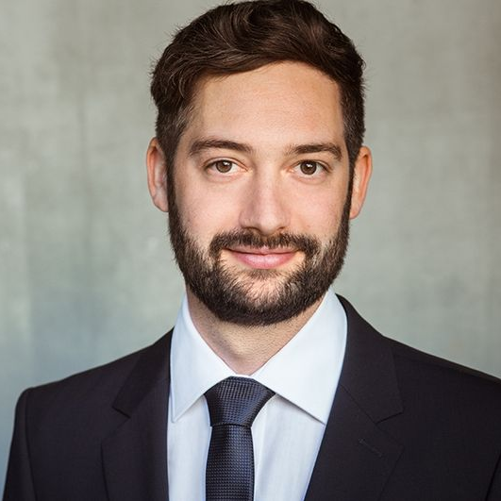
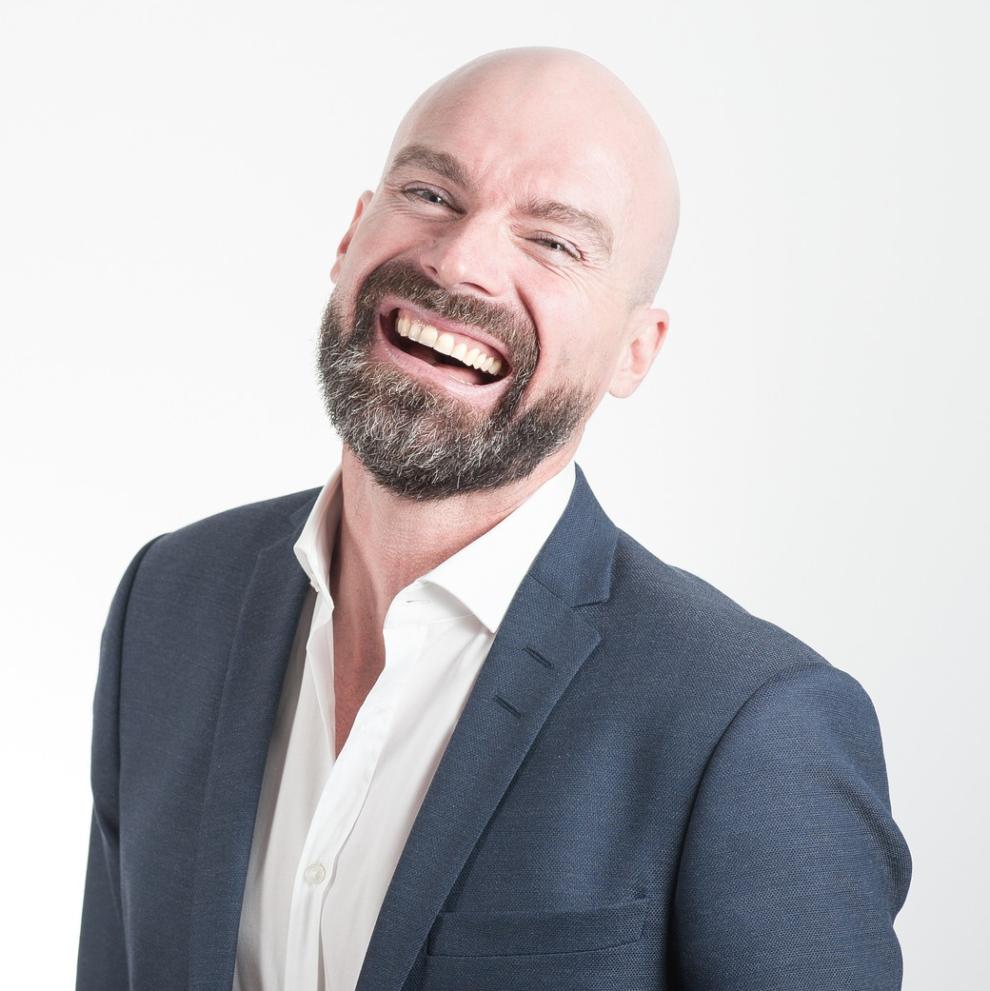
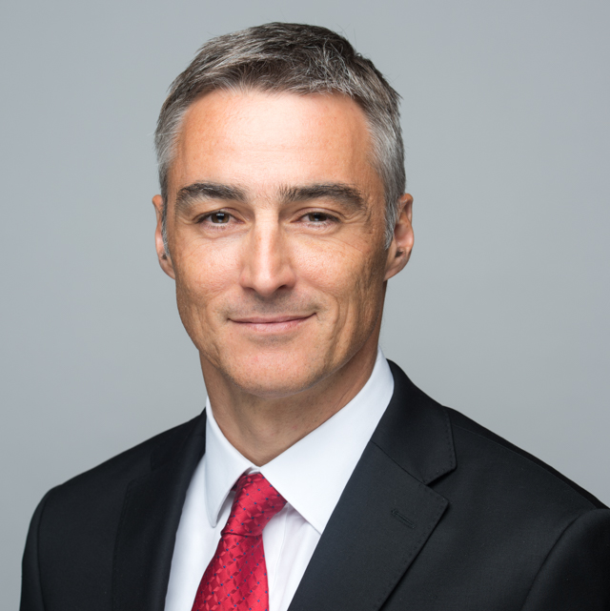
01
02
03
follow
history
services
teams
timeline
about
ALAN MARTIN
JHON DOE
PABLO PICASO
CEO, COMPANY NAME
CEO, COMPANY NAME
CEO, COMPANY NAME
Here Write Brief Message About Yourself
Here Write Brief Message About Yourself
Here Write Brief Message About Yourself

Slide 6






Web Design
Web Design
Here you need to add some brief about the service that your company is providing currently
Here you need to add some brief about the service that your company is providing currently
Web Design
Web Design
history
follow
services
teams
Here you need to add some brief about the service that your company is providing currently
Here you need to add some brief about the service that your company is providing currently
timeline
about
Web Design
Web Design
Here you need to add some brief about the service that your company is providing currently
Here you need to add some brief about the service that your company is providing currently

Slide 7



follow
history
services
teams
timeline
about
8M
6M
7M
Add Some Brief Text Here to Explain
Add Some Brief Text Here to Explain
Add Some Brief Text Here to Explain

Slide 8

Cảm ơn thầy cô và các bạn đã lắng nghe

